Slide 1
Five Themes of Geography
MR HeLP
M = Movement R = Region He = Human-Environmental
L = Location P = Place

Slide 2
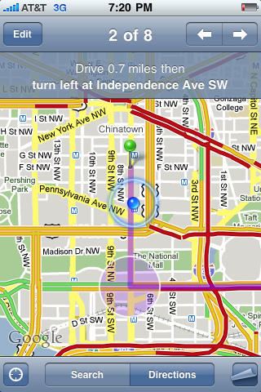
LOCATION
Location refers to where something or someone is located on the earth.
There are two (2) types of location.
ABSOLUTE
RELATIVE
How do you think they are different?

Slide 3
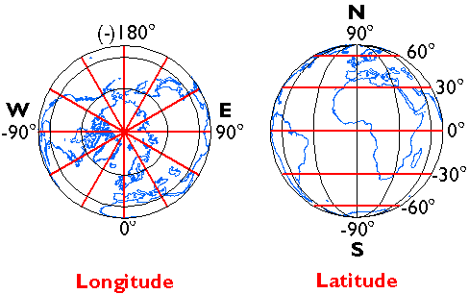
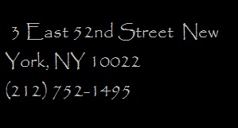
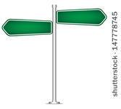
Absolute or Exact Location
Absolute or Exact : A location can be absolute (specific) as in coordinates of a map using longitude and latitude.
Absolute or Exact location is nothing more than a simple dot--often identified as a grid coordinate on the surface of the earth.

Slide 4
Relative Location
Relative: A location can be relative - examples: next door, nearby, a short drive, down the road a ways
Or, it can be in the same general location as another location - example: next to the post office.

Slide 5
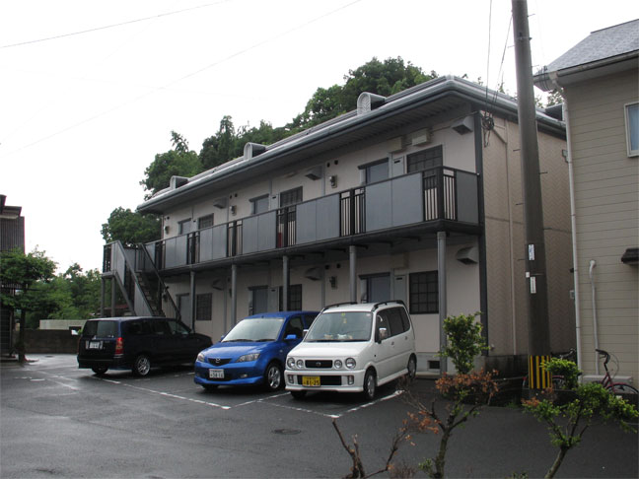
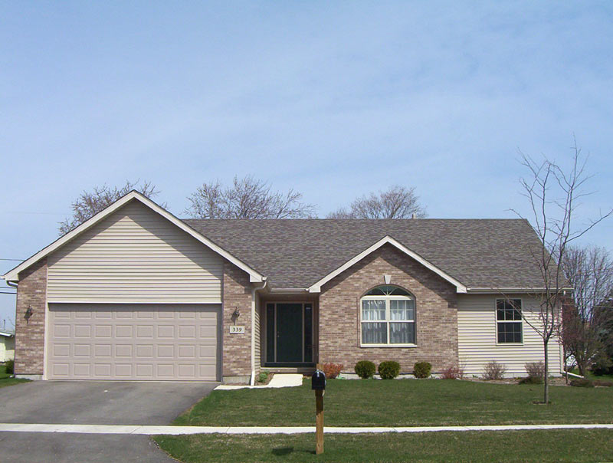
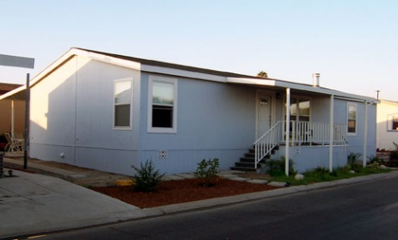
Location
The school has an absolute or exact location. It is 875 North 200 East.
Your home has an absolute or exact location. What is it?

Slide 6
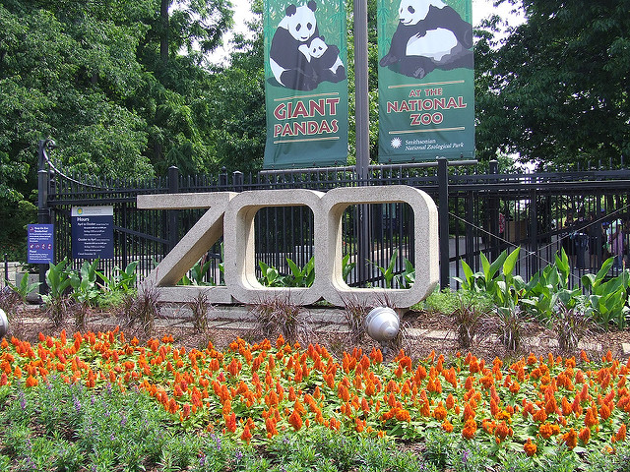
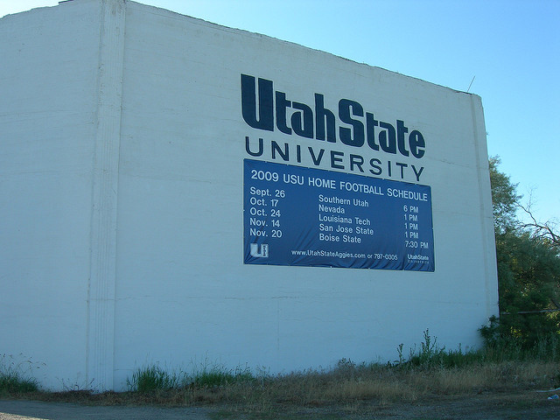
Relative Location
Relative location is the relationship of a place to other places.
Where is your home in RELATION to the following places?

