Slide 1
Five Themes of Geography
MR HeLP
M=Movement R=Region He=Human/Environmental
L=Location P=Place

Slide 2
MOVEMENT
Movement refers to the way people, products, information and ideas move from one place to another.

Slide 3
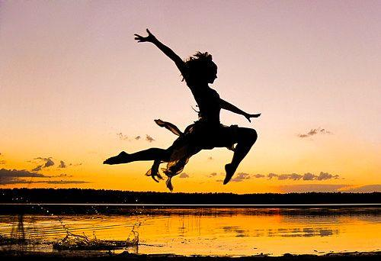
Movement: Movement refers to the way people, products, information and ideas move from one place to another.
Humans move, a lot! In addition, ideas, fads, goods, resources, and communication all travel distances.
Human Movement
Think of at least three (3) ways humans move.
Think of at least three (3) ways humans are moved.
Migration and Emigration?
Movement from one part of something to another.
Leaving one’s resident country to settle elsewhere.

Slide 4
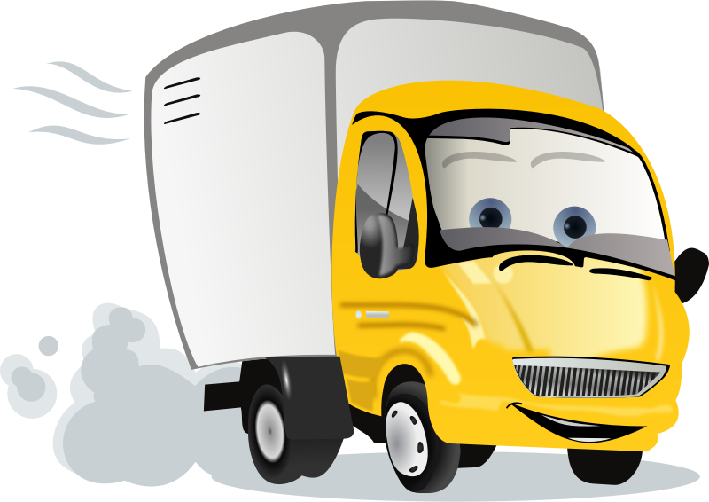
Movement: Movement refers to the way people, products, information and ideas move from one place to another.
Movement of GOODS/PRODUCTS
What are Goods and Products?
Tell your table partner about three (3) Goods or Products you can see in this classroom.
Tell your table partner about three (3) Goods or Products you had for breakfast.
Tell your table partner about three (3) Goods or Products you bought for school.
How did these things get to the store?
Why is this important to know?

Slide 5
Movement: Movement refers to the way people, products, information and ideas move from one place to another.
Movement of Information and Ideas
What is some information that needs to be shared quickly?
What are some ideas that have moved quickly?
How do ideas and information get from place to place?
Has the movement of information and ideas changed over the years?
How did people learn about the Bear River Massacre in 1863?
How did people learn about Michael Phelps winning 5 Olympic medals in 2016?

Slide 6
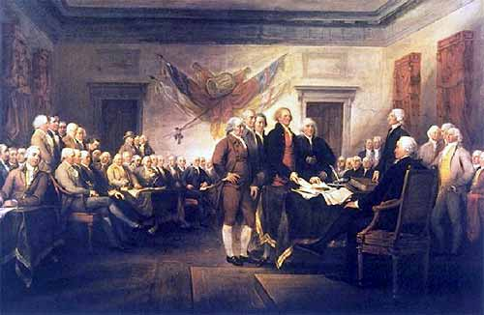
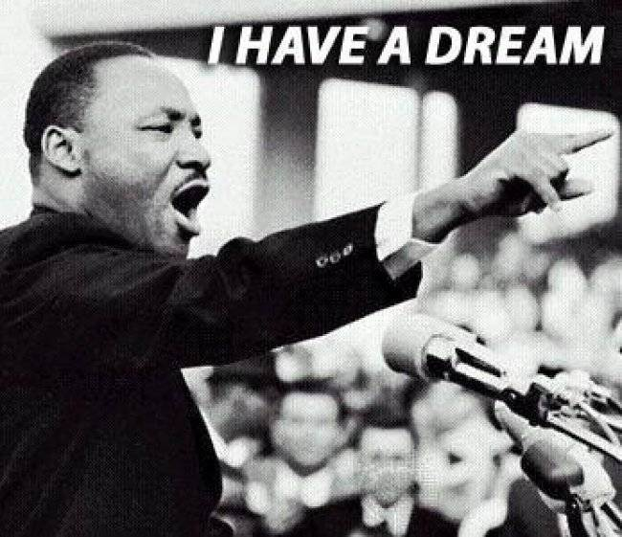
How did these movements change the world?

Slide 7
How did this movement change the world?

Slide 8
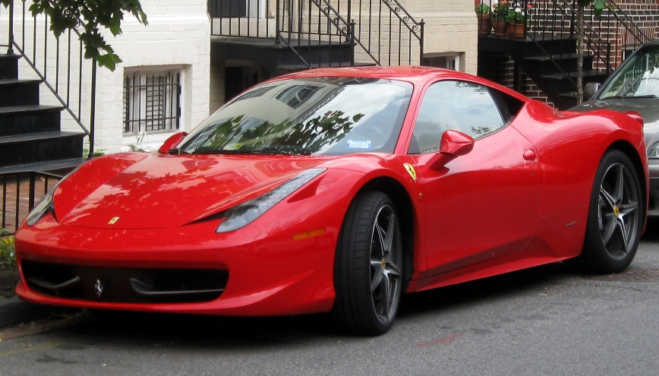
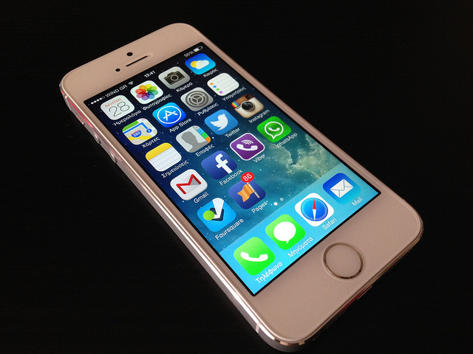
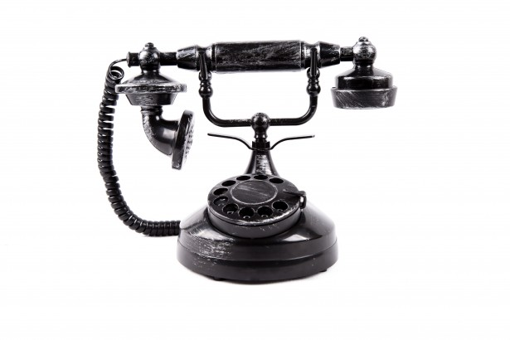
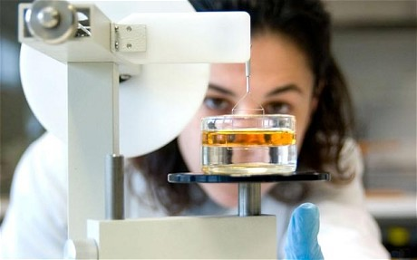
NOW OR THEN? WHICH DO YOU CHOOSE?

