Slide 1
Five Themes of Geography
MR HeLP
M = Movement R = Region He = Human Environmental
L= Location P = Place

Slide 2
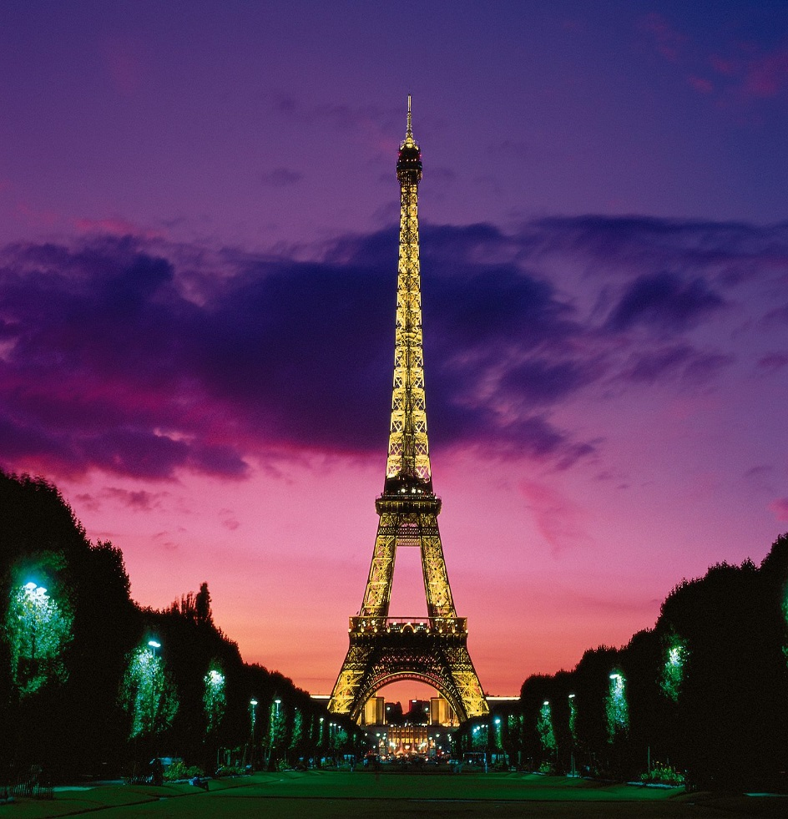
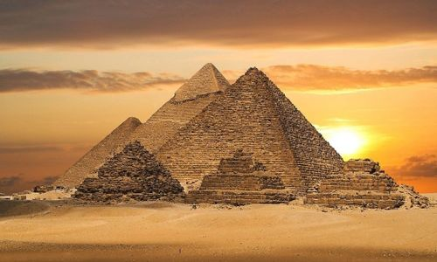
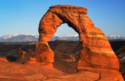
PLACE
A place is an area that is defined by everything in it. All places have features that give them personality and distinguish them from other places.

Slide 3
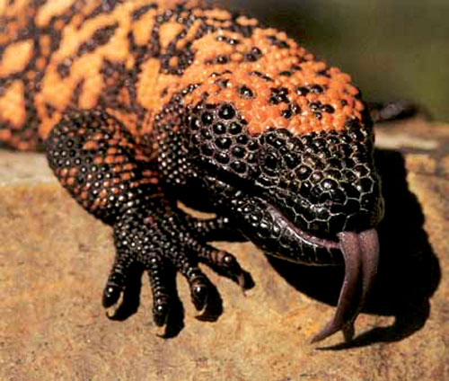
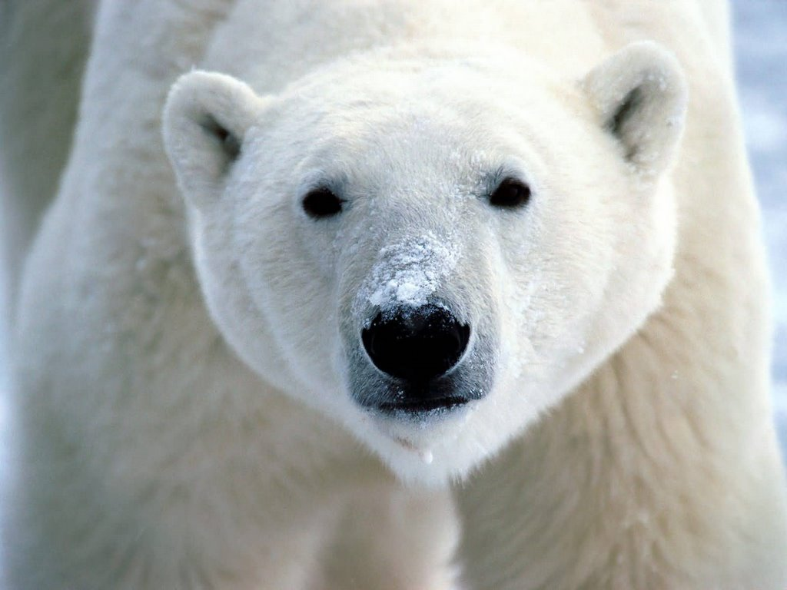
What is it like there? Physical Characteristics
The physical characteristics of a place make up its natural environment and are derived from geological, hydrological, atmospheric, and biological processes. They include land forms, bodies of water, climate, soils, natural vegetation, and animal life.

Slide 4
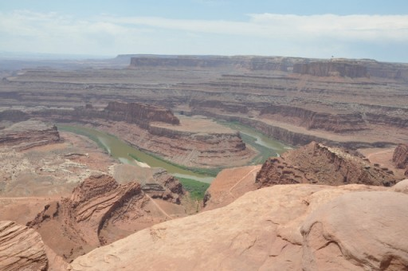
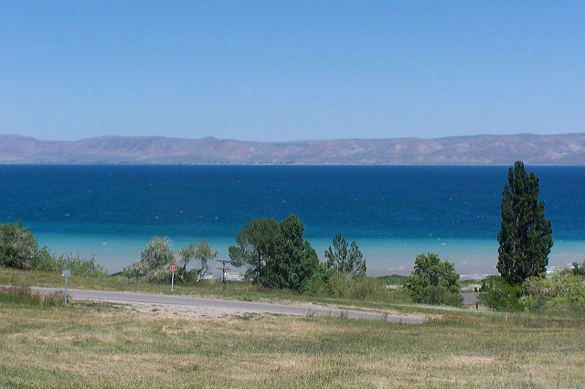
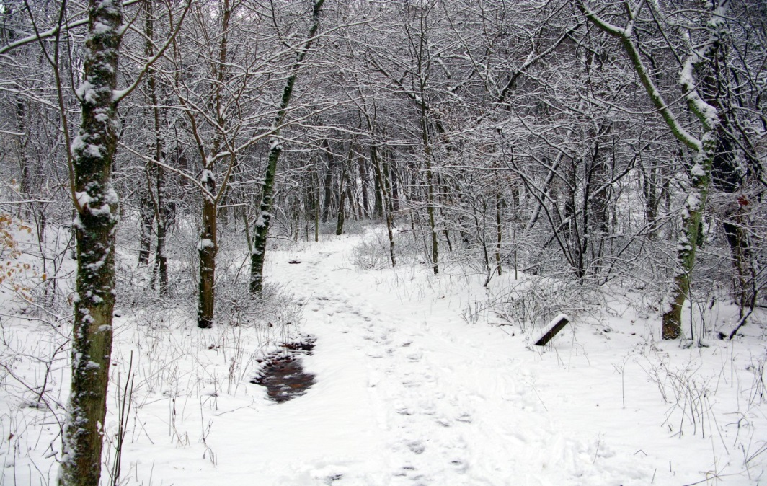
PLACE Physical Characteristics

Slide 5
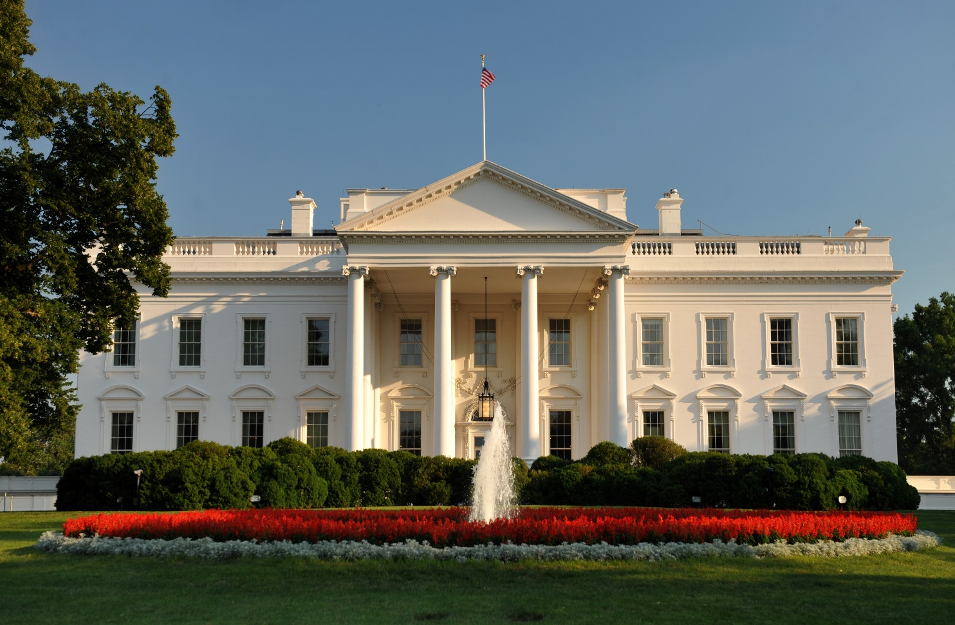
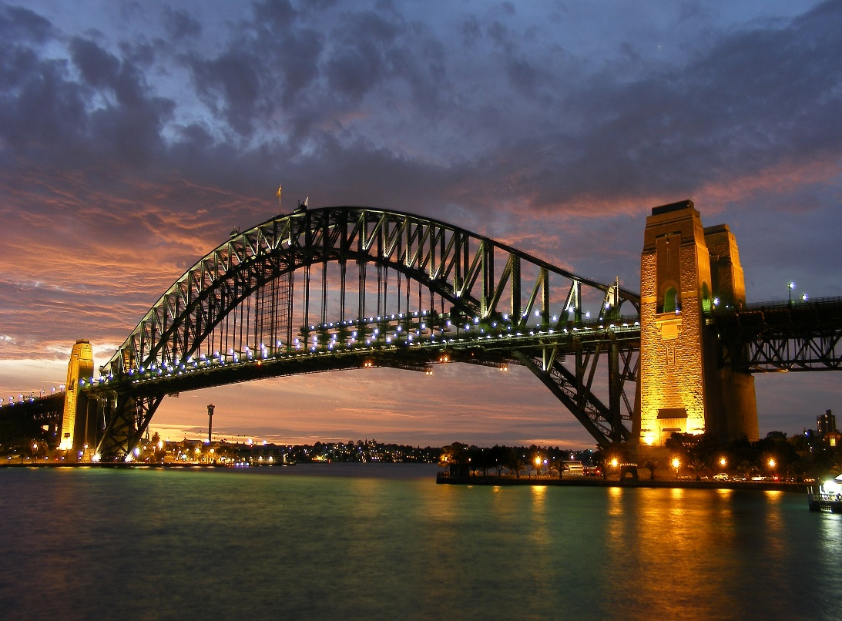
What is it like there? Human Characteristics
The human characteristics of a place come from human ideas and actions. They include bridges, houses, and parks. Human characteristics of place also include land use, density of population, language patterns, religion, architecture, and political systems.

Slide 6
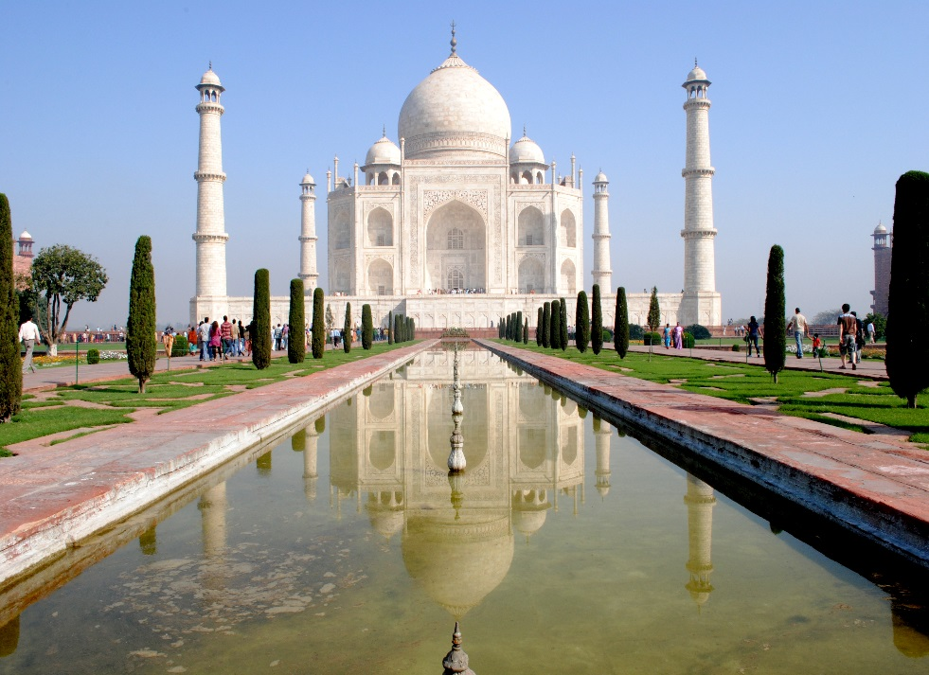
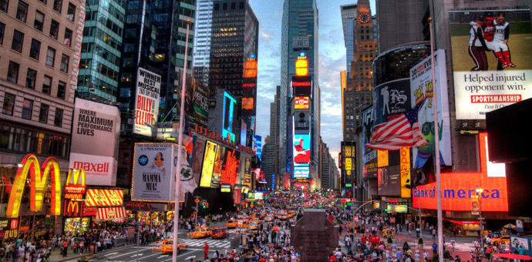
PLACE HUMAN CHARACTERISTICS

Slide 7
Five Themes of Geography Review
What does M stand for? Give me two examples.
What does R stand for? Give me two examples.
What does He stand for? Give me two examples.
What does L stand for? Give me two examples.
What does P stand for? Give me two examples.

