Slide 1
Five Themes of Geography
MR HeLP
M=Movement R=Region He=Human/Environmental
L=Location P=Place

Slide 2
REGION
A region is an area that is defined by certain similar characteristics.
Those unifying or similar characteristics can be physical, natural, human, or cultural.

Slide 3
FORMAL REGIONS
A FORMAL REGION is an area that is designated by official boundaries. These areas are publicly known and include cities, towns, states, counties and countries.

Slide 4
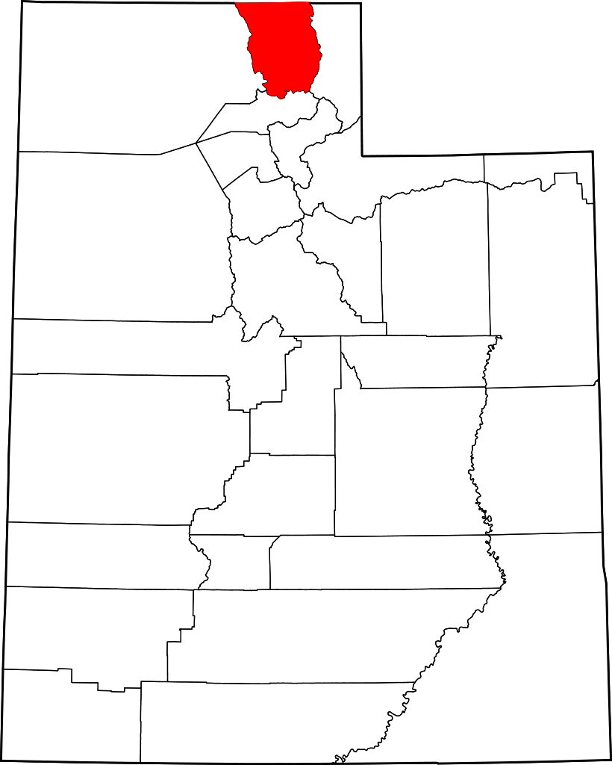
A FORMAL REGION is an area that is designated by official boundaries. These areas are publicly known and include cities, towns, states, counties and countries.
Where are you right now?
Make sure you include everything to make your answer fit the definition of a FORMAL REGION.

Slide 5
FORMAL REGIONS
With your table partner answer the following questions. When you have completed the answer, stand with your right hand up!!
Be prepared to share your answers!!!
Name 3 cities or towns in Utah.
Name 3 counties in Utah.
Name 3 states that touch Utah.
Name 2 countries that touch the United States.
Name 3 countries that do not touch the United States.

Slide 6
VERNACULAR REGIONS
A VERNACULAR REGION has no formal boundaries and is usually defined by the people living there. There can be disagreements about just how large a certain region can be.
Examples: Raise your hand and tell me where these places are located.
The Midwest Region
The Rocky Mountain Region
Middle East Region
Desert Southwest Region

Slide 7
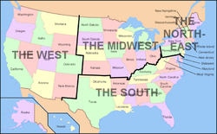
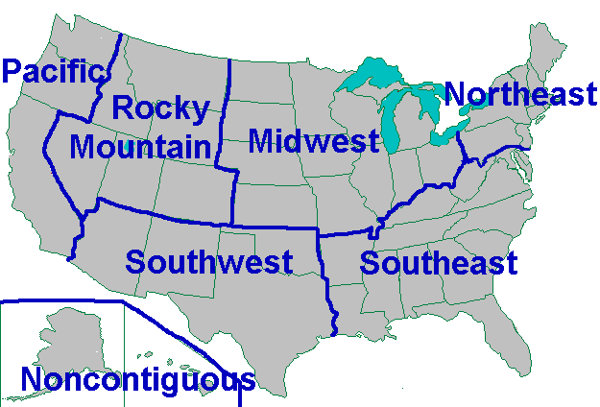
VERNACULAR REGIONS
Major Regions of the United States

Slide 8
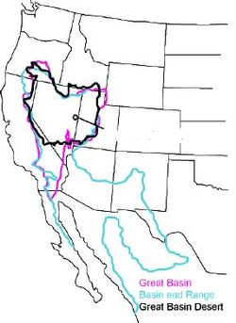
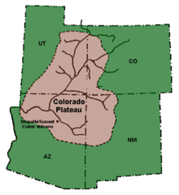
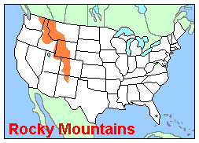
VERNACULAR REGIONS
There are three (3) regions that are included in Utah.

Slide 9
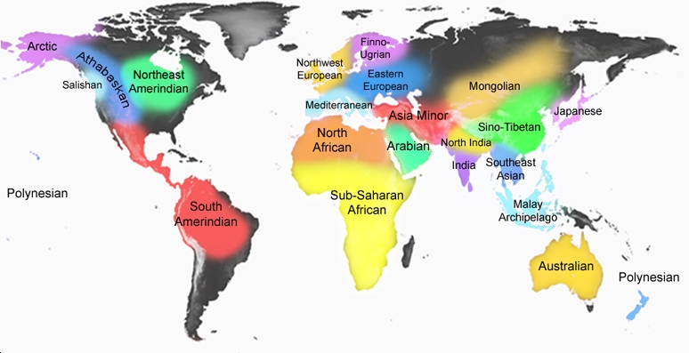
MAJOR REGIONS OF THE WORLD

Slide 10
Do You Know?
Formal or Vernacular
Formal or Vernacular
New York
Southern Utah
Africa
San Diego
Salt Lake
Scandinavian
Uintah Basin
France
Cliffside
Vermont
New England
Middle East
Far East
East Coast
Provo
Los Angeles
Texas
Polynesian Islands

Slide 11
How did you do?
Formal
Vernacular
New York
Africa
San Diego
Salt Lake
France
Vermont
Provo
Los Angeles
Texas
Southern Utah
Scandinavian
Uintah Basin
Cliffside
New England
Middle East
Far East
East Coast
Polynesian Islands

