Slide 1
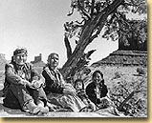
The Navajo
The Navajo called themselves the Dinè, or “the people.”
The Navajo lived in the southeastern corner of Utah, below the San Juan River.
Many Navajo today live on a reservation in that same area.
Notes:
19. Where were the Navajo located?

Slide 2
The Navajo: Survival
The Navajo used horses for hunting and carrying heavy loads.
They also raised sheep and goats.
Some clans closer to the San Juan River practiced irrigation and farming.
Notes:
20. What two animals besides horses, did the Navajo raise?

Slide 3
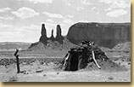
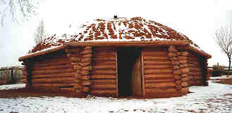
The Navajo: Home Life
The Navajo lived in hogans. They considered their homes to be a symbol of spiritual connection to Mother Earth.
Hogan doors always face east to meet the morning sun.
Hogans were placed far apart; there were no villages.
Notes:
21. What kind of home did the Navajo live in?

Slide 4
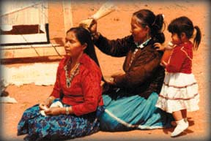
The Navajo: Families
The most important person in a Navajo family is the mother.
Women own the house, the sheep, the goats, and any wages earned from weaving.
Men own the horses, the wages earned from their jobs, and any items or money they brought into the marriage.
Navajo men and their mothers-in-law are not allowed to talk to-or even look at-each other. This custom probably reduces the number of family arguments!

Slide 5
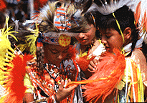
The Navajo: Children
Children play an important role in a Navajo family. Even when they are very young, Navajo children care for some of the family’s sheep or help with grown-up chores.
Each Navajo child is given a secret “war” name by the parents, used only for special religious ceremonies.

Slide 6
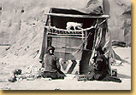
The Navajo: Clothing
The Navajos sheered wool from their sheep and made it into yarn.
The yarn was then dyed from plants to make colors.
The dyed yarn was woven into rugs, blankets, and cloth.
Notes:
22. How did the Navajo make clothing that is unique to the other tribes?

Slide 7
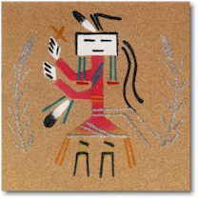
The Navajo: Religion
Navajo religion is sometimes called “The Way.”
It is a code of behavior for everyday life, not just weekly worship.
Ceremonies are called “ways.”
One of the most important ceremonies is called the “Nightway.”
Nightways are nine day healing ceremonies. Sand paintings (2:20) are made as part of the Nightway.

Slide 8
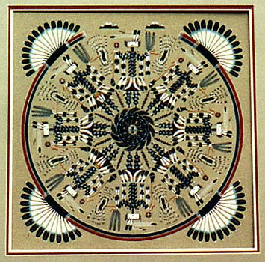
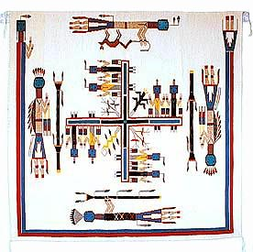
Navajo Sand Paintings

