Slide 1
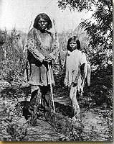
The Paiutes
The Paiutes lived in the southwest corner of Utah.
Notes:
16. Where were the Paitues located?

Slide 2
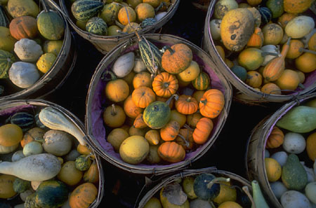
The Paiutes: Survival
Like the Goshutes, the Paiutes lived in a very dry region with little rain.
Like all modern Utah Indian tribes, the Paiute were also hunter/gatherers.
Some Paiutes irrigated some crops including corn, beans, squash, and wheat.
Notes:
17. What crops did the Paiutes grow?

Slide 3
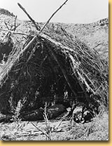
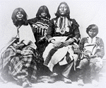
The Paiutes: Home Life
The Paiutes also lived in brush wiki-ups in the summer and caves during the winter.
They lived in large family groups found in small villages.
Like many tribes, the Paiutes used cradleboard to keep young children safe while the mother worked.
Notes:
18. What kind of home did the Paiutes live in?

Slide 4
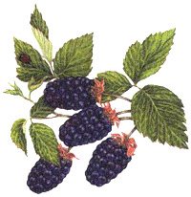
The Paiutes: Families
Small family groups would travel separately collecting seeds, berries, roots, and hunting small animals, deer, mountain sheep, elk, and fish.
These groups met and intermarried with other Paiutes, as well as other Indian tribes.

Slide 5
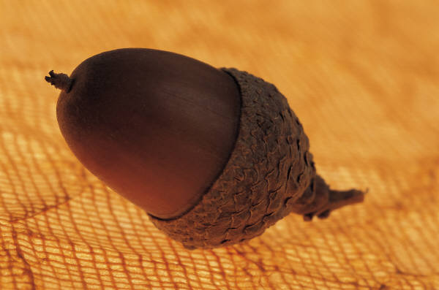
The Paiutes: Children
Children helped their parents gather food goods to be stored for the winter.
Children learned from their parents and grandparents about animals, plants, and storytelling.

Slide 6
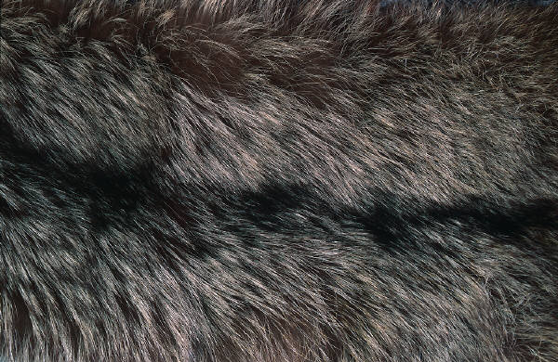
The Paiutes: Clothing
Similar to the Goshute people, the Paiutes had very little use for clothing in warm weather. Often during the summer, Paiute children would wear no clothes at all.
During the colder winter months, everyone wore shirts and used blankets made of rabbit skin.

Slide 7
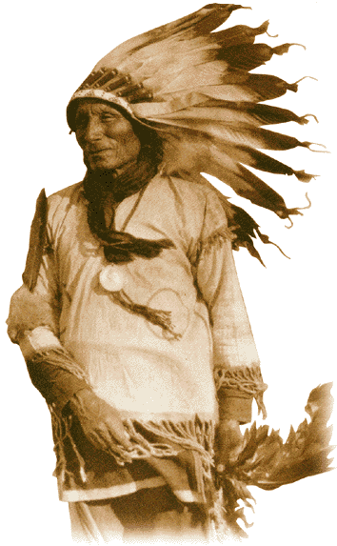
The Paiutes: Religion
A Paiute man named Wovoka introduced the Ghost Dance, a religious movement that spread throughout the nation.
The Ghost dance (2:05) represented the return of all Indians who had died as a result of contact with non-Indians.
Another Paiute dance is the Circle Dance.

