Slide 1
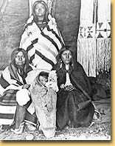
The Shoshone
The Shoshone lived in the mountains and valleys of northern Utah.
The name “Shoshone” means “valley dwellers.”
Today, many Shoshone live on the Fort Hall Reservation in southeastern Idaho, which they share with the Bannock tribe.
Perhaps the most famous Shoshone was Sacagawea, the woman who led Lewis and Clark through the west.
Notes:
8. Where were the shoshone located?

Slide 2
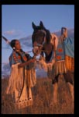
The Shoshone: Survival
In the mountains and valleys where the Shoshone lived, food was all around them. However, they had to follow the animals, so they were called “nomads.”
Like the Ute clans, the Shoshone hunted animals such as buffalo, deer, and antelope and gathered nuts and berries for food.
They also raised horses for hunting and moving around.

Slide 3
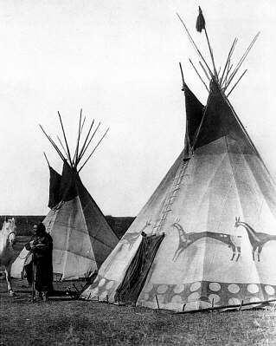
The Shoshone: Home Life
The Shoshone also constructed tepees from animal hide and poles.
This picture shows a tepee that has been painted, perhaps with a clan or family symbol.
Some other Shoshone bands dug shelters out of hillsides or wicki-ups.
Notes:
9. What kind of home did the Shoshone live in?
10. What might the paint on the tepee represent?

Slide 4
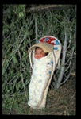
The Shoshone: Families
Men and women had equally important roles. The men hunted and served as chiefs, or leaders, of the bands. Women raised children and gathered plants.
Like many other Native American tribes, the Shoshone did not spank or punish their children.

Slide 5
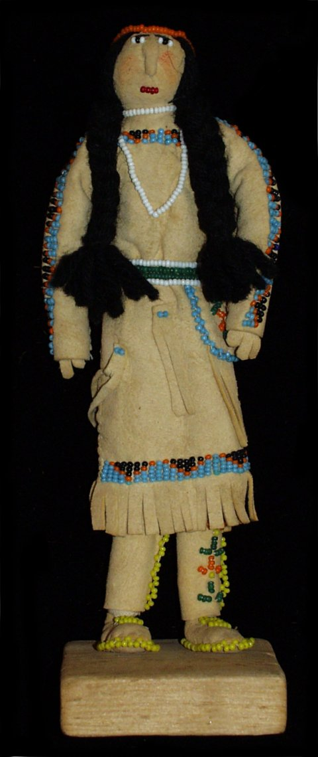
The Shoshone: Children
Children did not have formal schooling. They learned by working alongside adults and by listening to songs and stories.
Many children would make balls of hide and rabbit hair or dolls to play with.

Slide 6
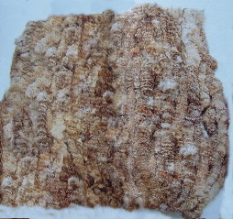
The Shoshone: Clothing
The Shoshone’s clothing was almost identical to the Ute’s. Animal skins and woven grasses made most of their clothing.
In the winter, women would often wear a special robe made of about forty woven rabbit skins.
Notes:
11. How many rabbits does it take to make a robe?

Slide 7
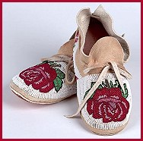
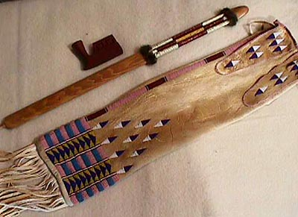
The Shoshone: Clothing Continued
Beadwork was also an important part of Shoshone clothing and ceremonial items.
Pictured here are beaded moccasins and a ceremonial peace pipe with beaded bag.

Slide 8
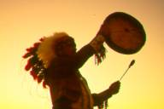
The Shoshone: Religion
The Shoshone believed in one being called Duma Appáh, Our Father, or the Creator.
Each morning the Shoshone faced the sun in the east and sang a prayer to Appáh.
Appáh was said to have created Earth with the help of the animal creatures, especially Coyote.

